Slide 1

Robust Intrusion Detection in IoV Using PU Learning and Supervised Ensembles with Synthetic Data Augmentation on CICIoV2024
Yashwanth Reddy Kovvuri
Department of Computer Science Bagley College of Engineering
Mississippi State University
Mississippi, United States
yk291@msstate.edu

Slide 2
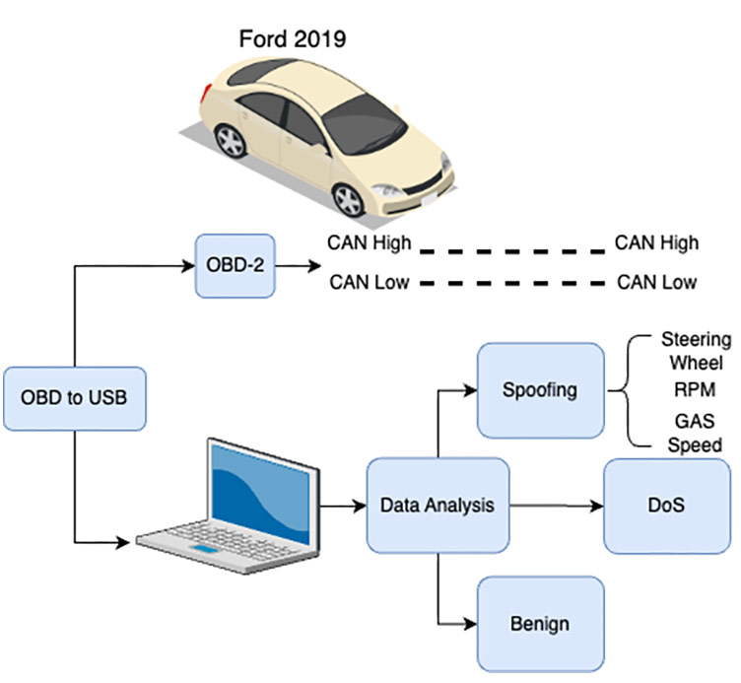
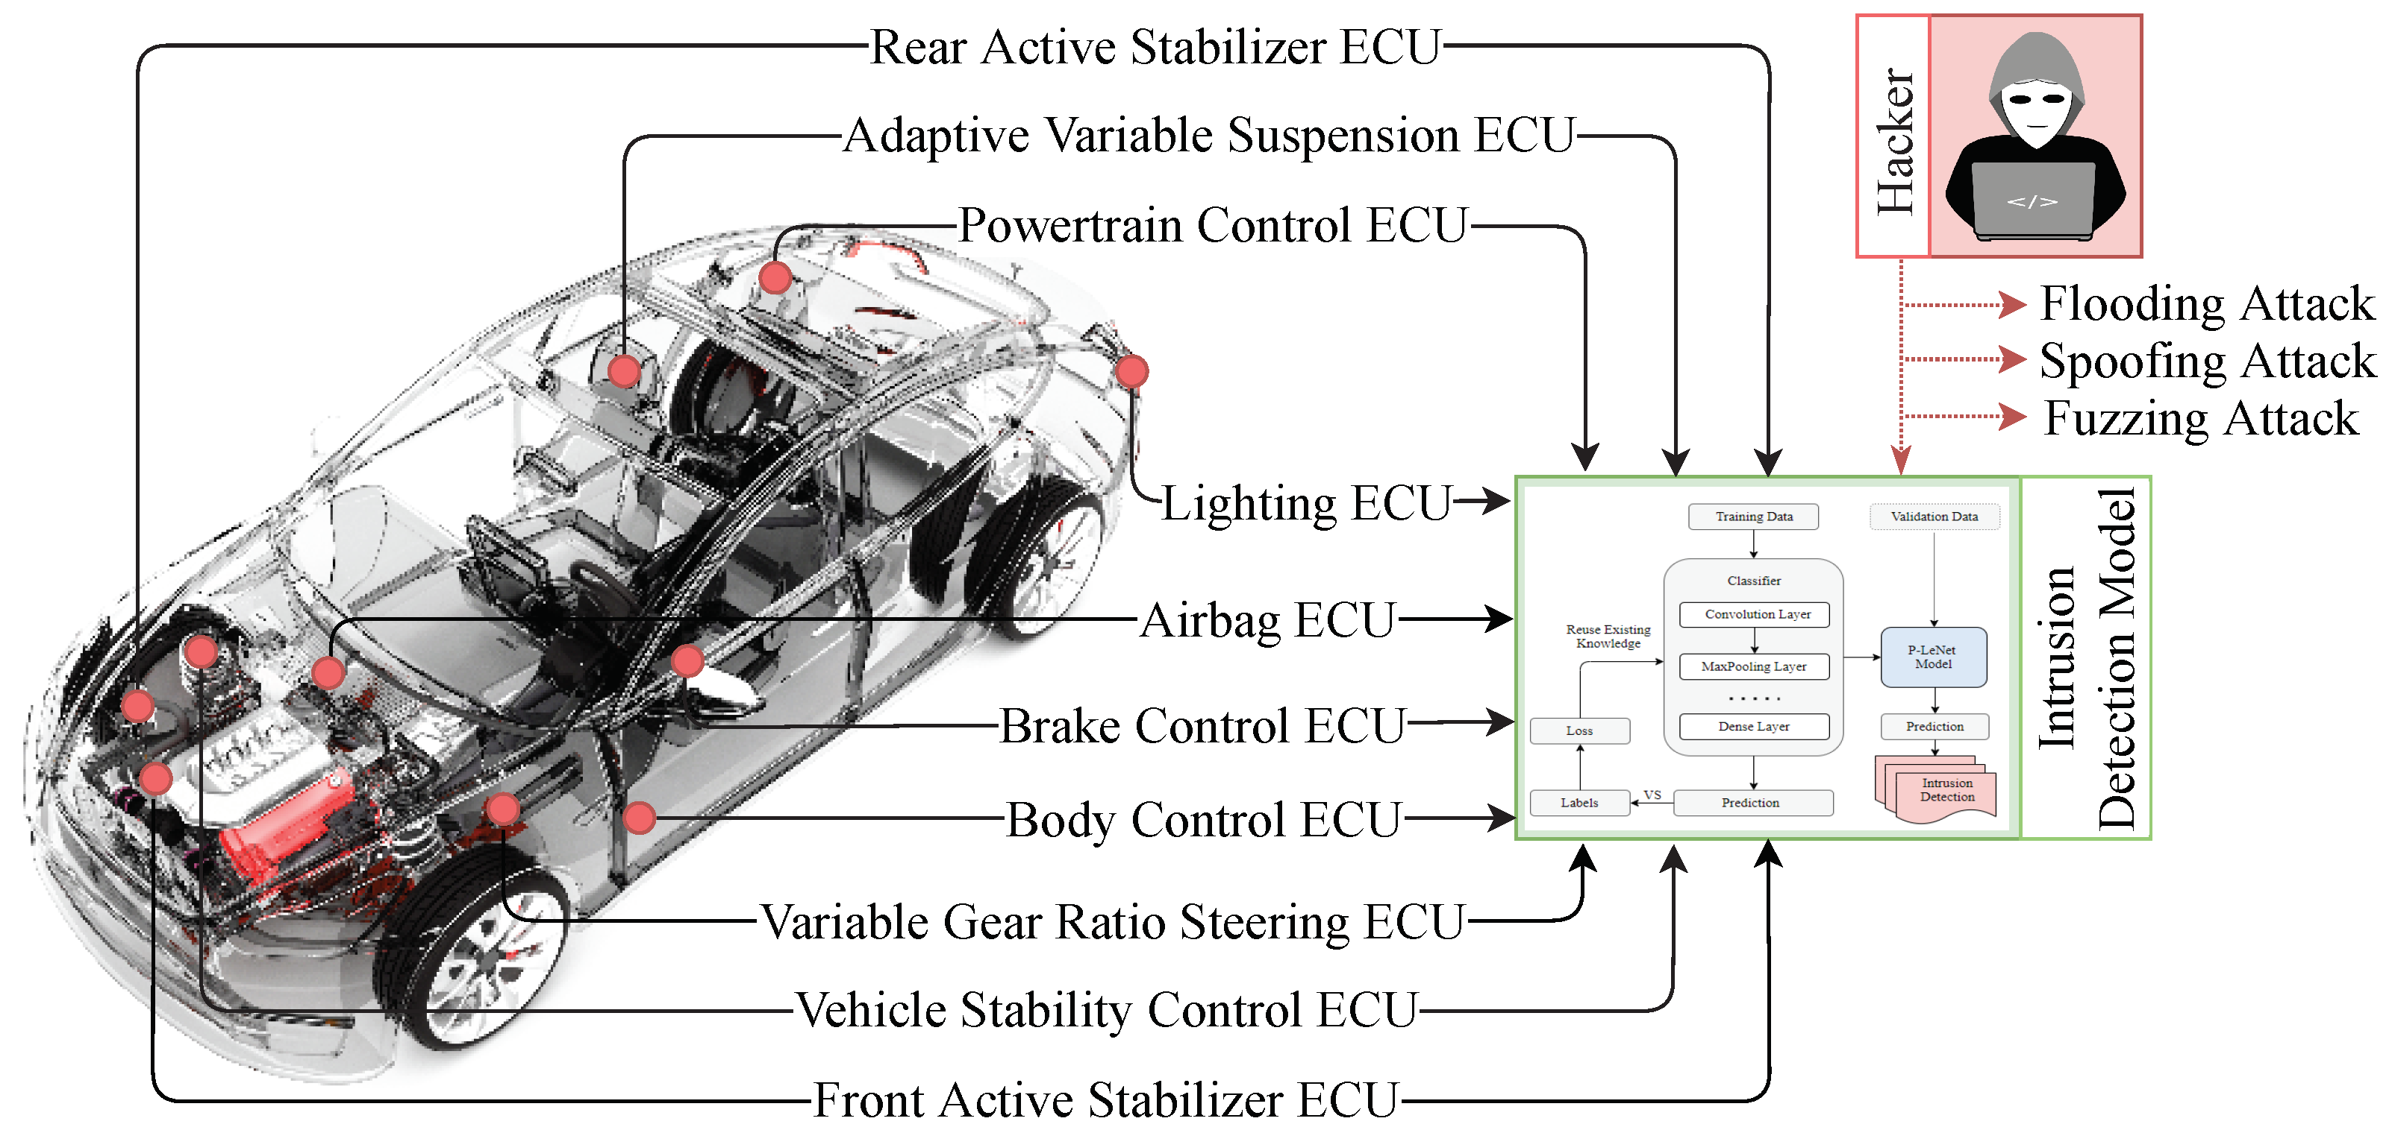
Introduction
Internet of Vehicles (IoV) connects vehicles, infrastructure, and cloud systems.
It enables V2V, V2I, and V2C communications for real-time coordination.
With increased interconnectivity, cybersecurity threats like DoS and spoofing have become critical.
IDS (Intrusion Detection Systems) are vital to securing IoV networks

Slide 3

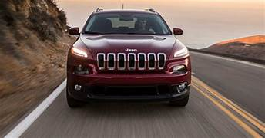
Real-World Example
Charlie Miller and Chris Valasek
2014 Jeep Cherokee
Activated the windshield wipers and washers.
Changed the radio station and increased the volume.
Adjusted the air conditioning settings.
Displayed their images on the infotainment screen.
Disabled the transmission, causing the vehicle to slow down and stop.

Slide 4
Problem Statement
Internet of Vehicles (IoV) is highly vulnerable to cyber-attacks such as Denial-of-Service (DoS) and spoofing.
Traditional IDS approaches require fully labeled data, which is often scarce and expensive to obtain in real-world IoV systems.
High false positives can disrupt vehicle operations and lead to unsafe driving decisions.
There is a pressing need for an intelligent intrusion detection approach that works effectively with limited or partially labeled data.
Can we accurately detect attacks in IoV with only a few known attack samples?

Slide 5
Objective
Develop an intelligent Intrusion Detection System (IDS) tailored for IoV networks.
Detect DoS and spoofing attacks using the CICIoV2024 dataset.
Compare traditional Supervised Learning models with Positive-Unlabeled (PU) Learning.
Evaluate the effectiveness of synthetic data augmentation for improved model performance.
Analyze model outcomes using performance metrics and visualizations to guide future IDS development.
This project aims to bridge the gap between real-world IoV data limitations and practical intrusion detection using a mix of supervised and semi-supervised learning methods.

Slide 6
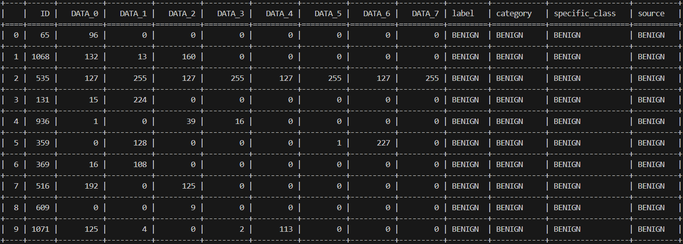
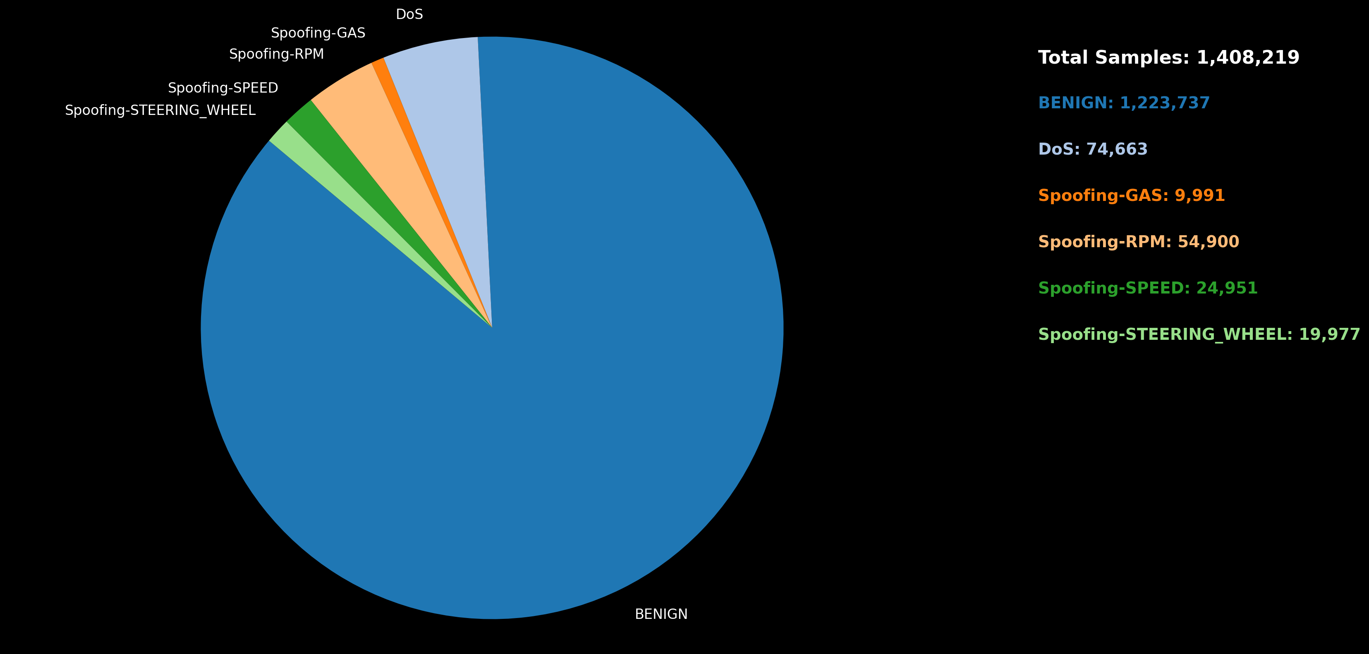
Dataset
Dataset Collected by Canadian Institute for Cybersecurity (CIC) – 2024
Data from a 2019 Ford vehicle with all ECUs intact, simulated under real-world driving and attack scenarios
Captures CAN Bus traffic via OBD-II port
Two main attacks:
Denial-of-Service (DoS)
Spoofing

Slide 7
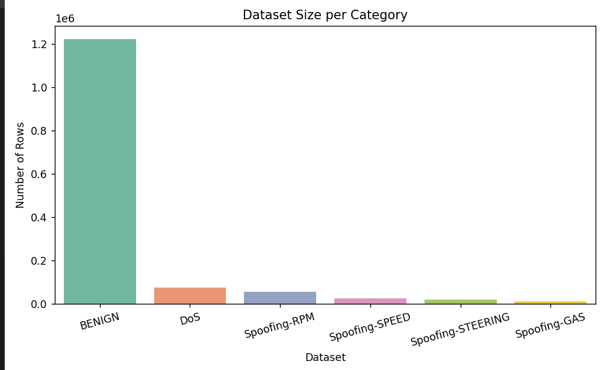
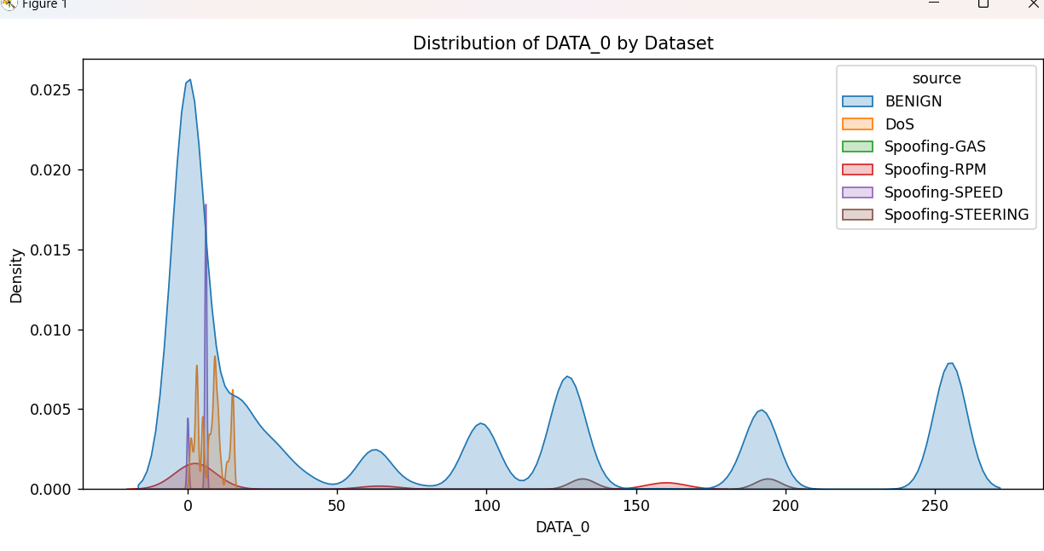
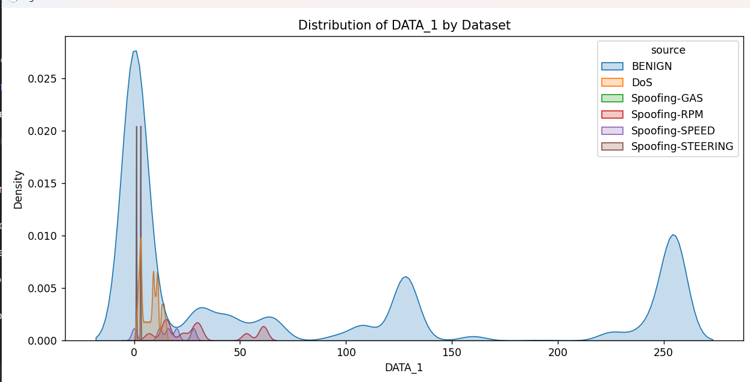
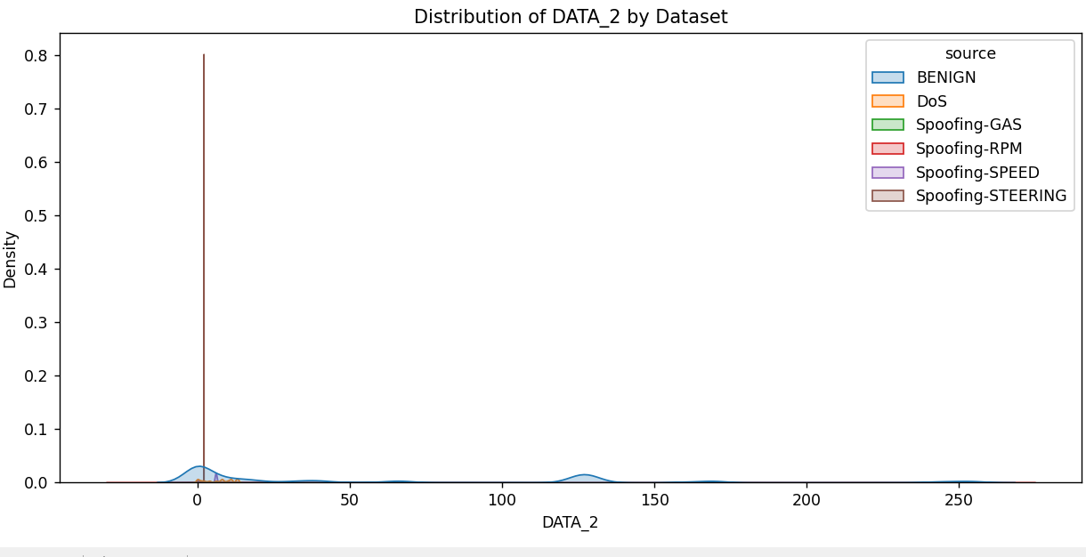
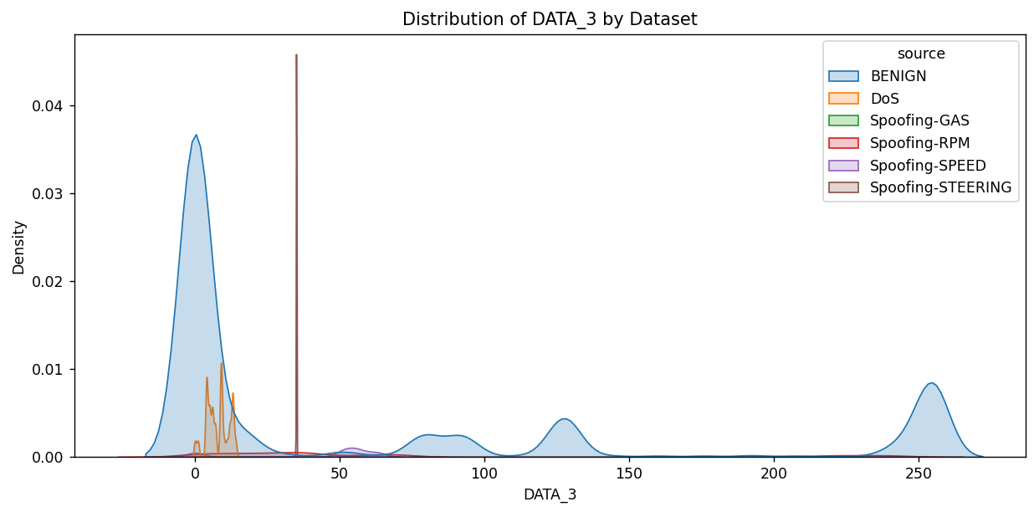
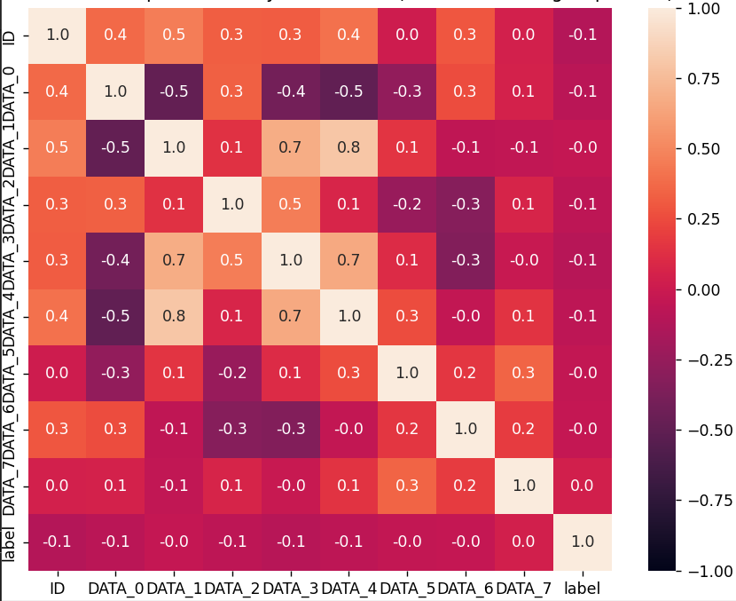
Notes:
Bar Chart – Huge class imbalance, most data is benign(normal traffic)
KDE Plot (data0, data1, data2) – show different distribution for attacks and benign
Heatmap – Dark Red(Highly positively correlated(+1)
Dark Blue(negatively correlated(-1)
Light Colors – Weak correlation

Slide 8

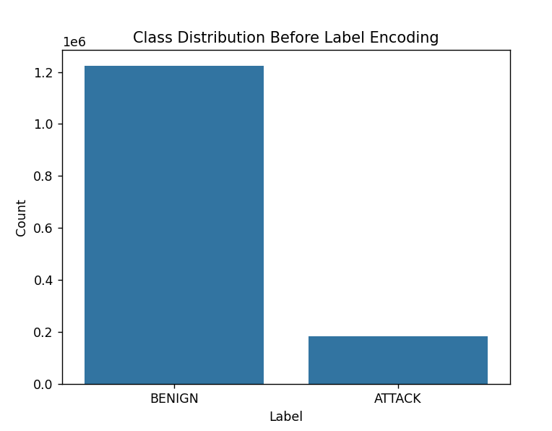
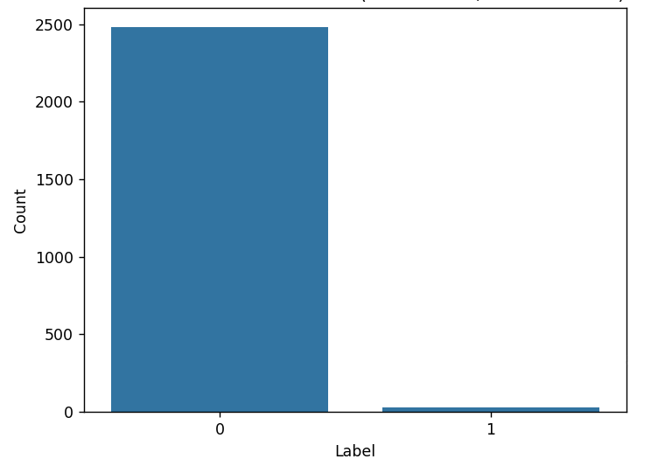
Data Preprocessing
Original Data:
Benign - 1,223,737
Attack – 184,482
Total Combined Data – 1,408,210
After Removing Duplicates and Missing Values (1,404,631)
"Why does the CAN Bus dataset contain such a large number of duplicate messages?"
Total Combined Data – 3,588
Benign – 3,547
Attack – 41
"How does removing duplicates benefit our intrusion detection model?"
Notes:
In a real-world vehicle, the CAN (Controller Area Network) Bus continuously transmits the same types of messages repeatedly at very short intervals (every few milliseconds) to ensure that critical vehicle functions (like speed, brake status, RPM, steering angle) are monitored in real-time.
During both normal operation and attack scenarios (especially during DoS or spoofing attacks), the network logs high-frequency, identical messages many times.
As a result, when data is captured for analysis, it naturally contains millions of duplicate frames because:
The system broadcasts frequent status updates even when the vehicle’s status doesn’t change.
DoS attacks flood the CAN Bus with a huge volume of identical malicious packets.
Therefore, the duplication is a natural outcome of the high-frequency, repetitive communication patterns of CAN Bus systems in real-world vehicles.
It avoids overfitting, improves generalization, reduces bias, and trains the model on unique meaningful patterns.

Slide 9
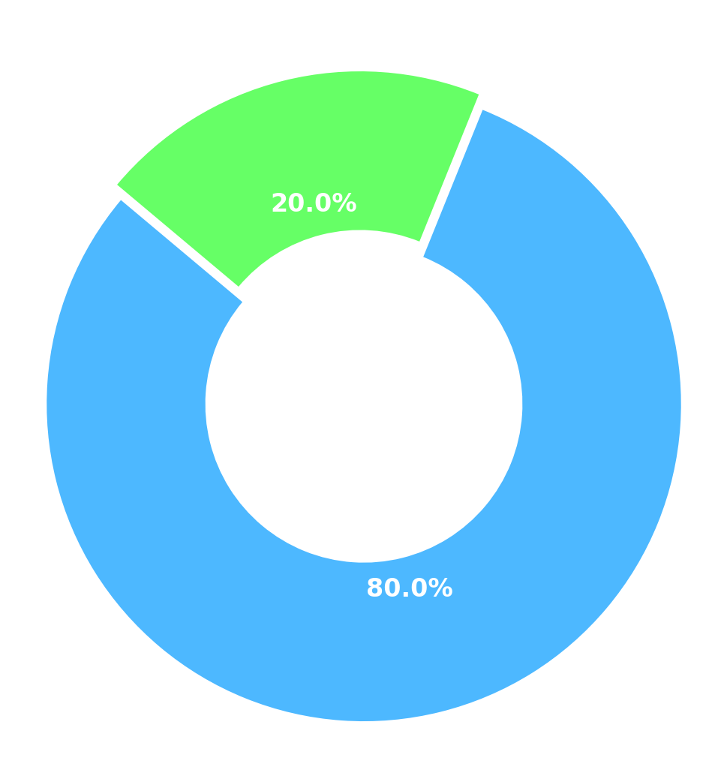
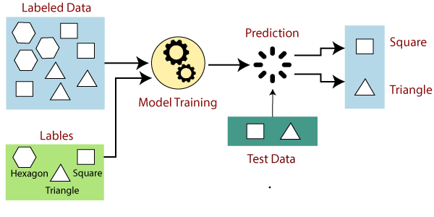
Modeling Approach
Supervised Learning
Preprocessed dataset was split into 80% - 20%
Training – 80%
Testing – 20%
Cross Validation ( 5-Fold Stratified)
~ Helps in robust model training and hyperparameter tuning without overfitting
~ Each model is trained and validated multiple times on different splits.
"We used 5-Fold Stratified Cross-Validation to maintain the original class distribution (benign vs attack) in every fold."
Supervised models
Random Forest
XGBoost
SVM
Naïve Bayes
Voting Classifier

Slide 10
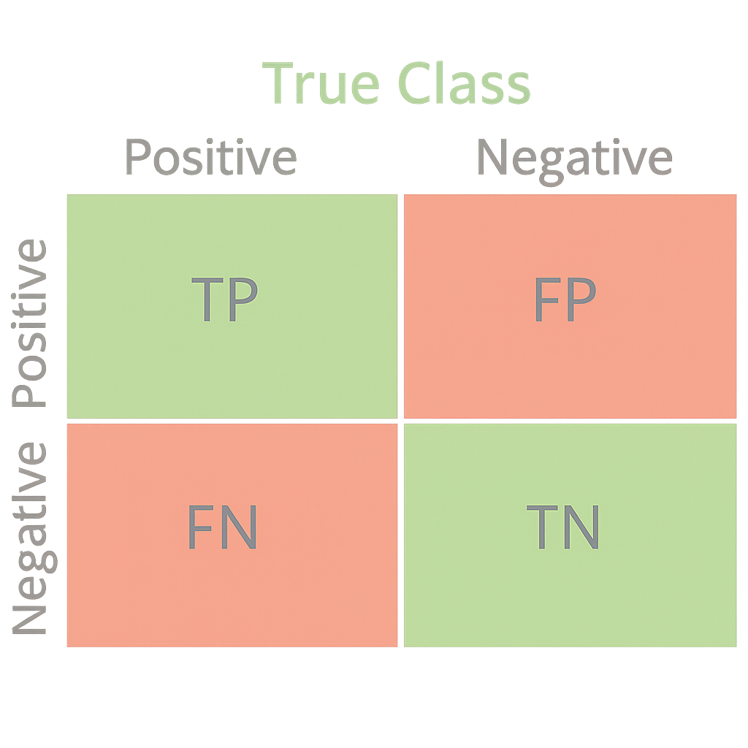
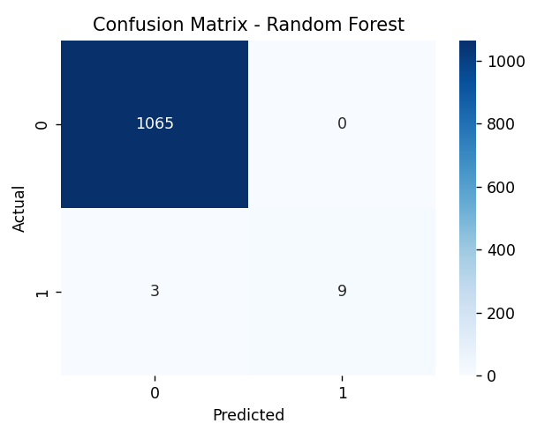
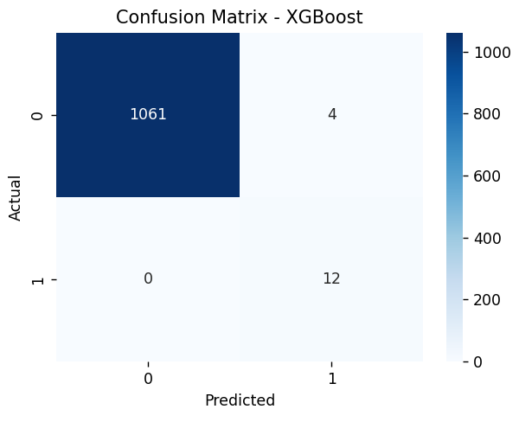
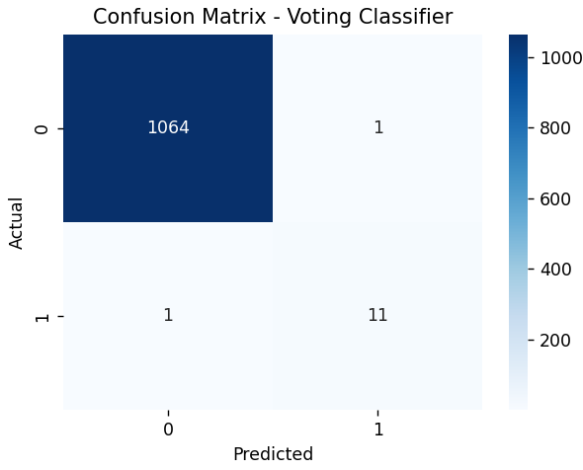

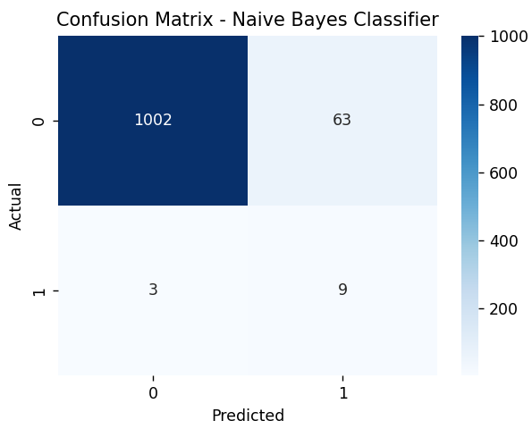
Supervised Learning
Confusion Matrix
Prediction performance for Random Forest, XGBoost, SVM, Voting Classifier, and Naive Bayes based on actual vs predicted classes
Random Forest achieved zero False Positives and only three False Negatives, showing excellent performance.
XGBoost had no False Negatives but slightly more False Positives.
Voting Classifier maintained a very good balance with very few mistakes on either side.
SVM had minor errors — two False Positives and two False Negatives.
Naive Bayes struggled with many False Positives, causing lower precision.
Notes:
It is crucial because in cybersecurity and intrusion detection, our main goal is to minimize False Negatives — meaning, we don't want to miss real attacks. False Positives are acceptable to some extent (false alarms), but missing an attack could be critical.
TP – correctly identified attacks
TN – correctly identified benign
FP – benign samples wrongly predicted as attacks
FN – Attacks wrongly predicted as benign

Slide 11
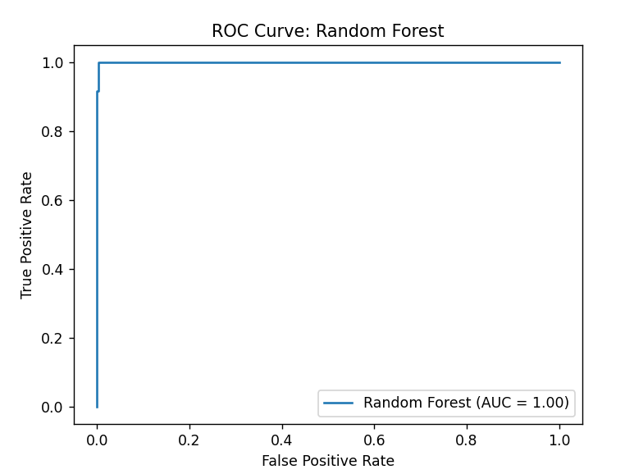
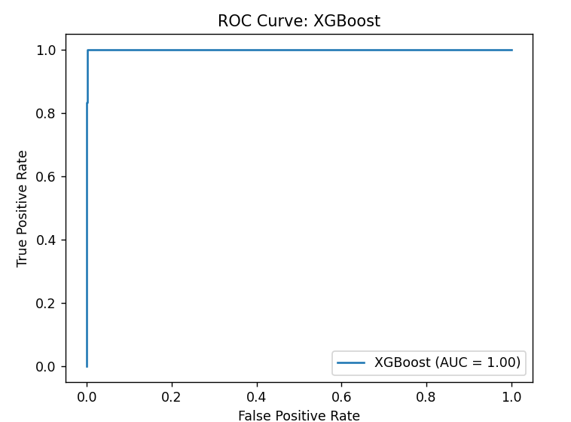
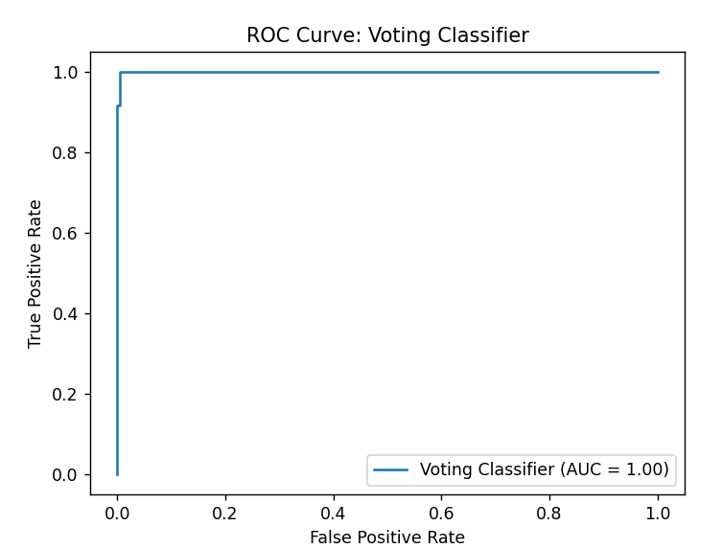
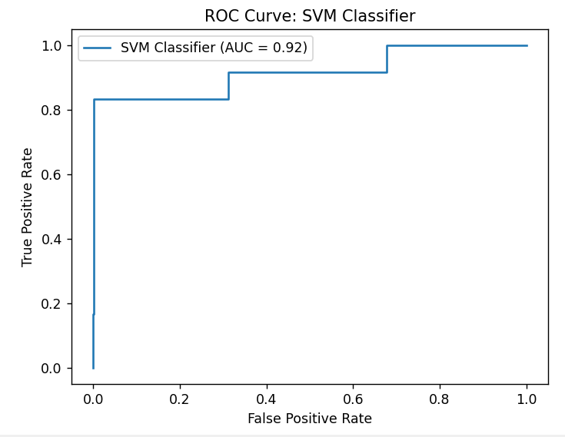
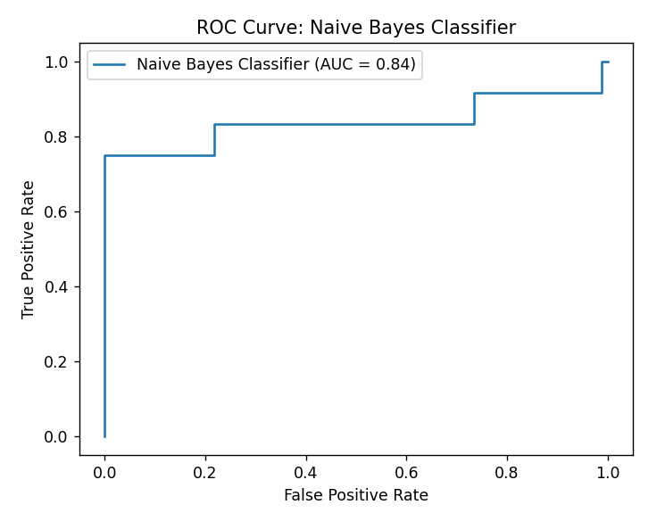
ROC – AUC Curve
What is ROC-AUC curve?
Shows the model’s ability to distinguish between classes(attack vs benign) at various threshold settings.
AUC ~ 1.0 (Excellent Classification)
Random forest, XGBoost, Voting Classifier – Perfect Separation
SVM – Good, but not perfect separation
Naïve Bayes – Lower ability
Notes:
Plots true positive rate(recall) against false positive rate
Curve closer to top left means better model performance
AUC – area under curve
Higher AUC(better ability to distinguish between classes

Slide 12
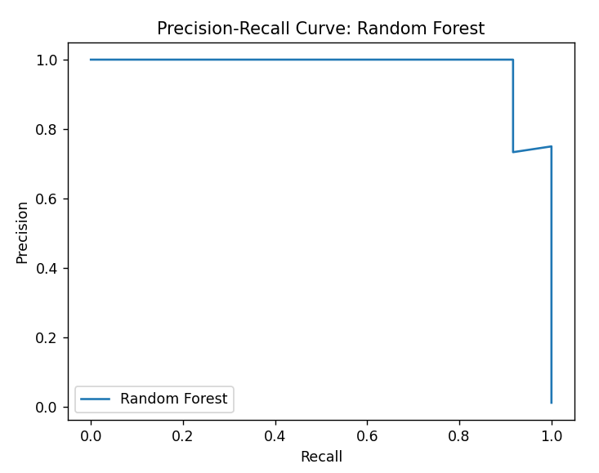
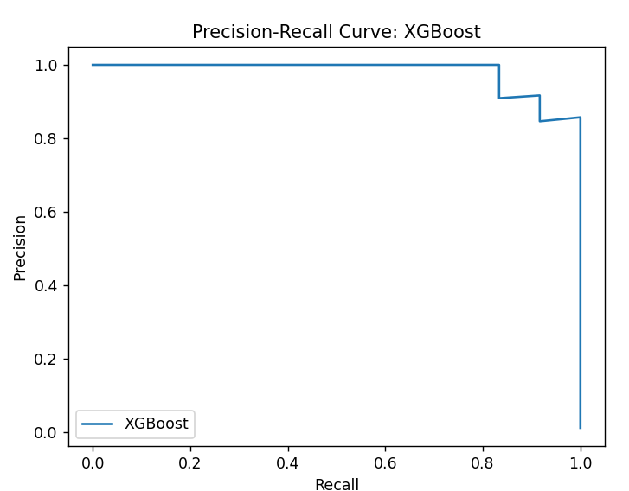
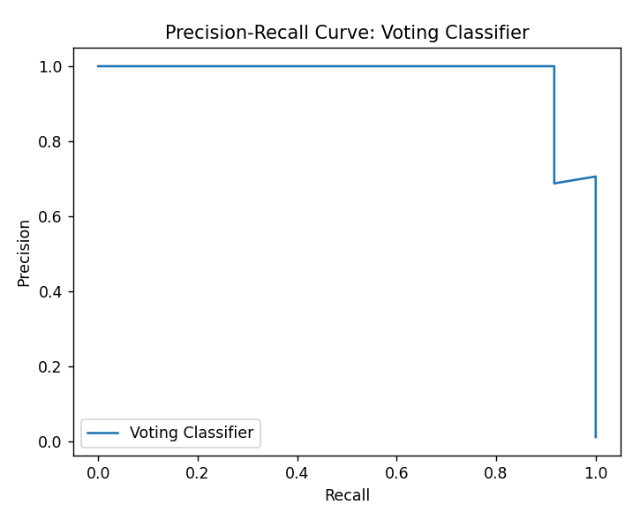
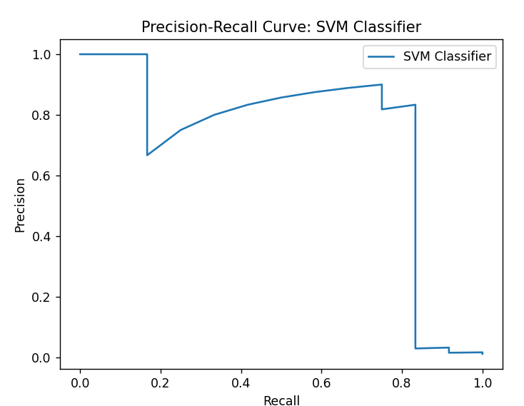
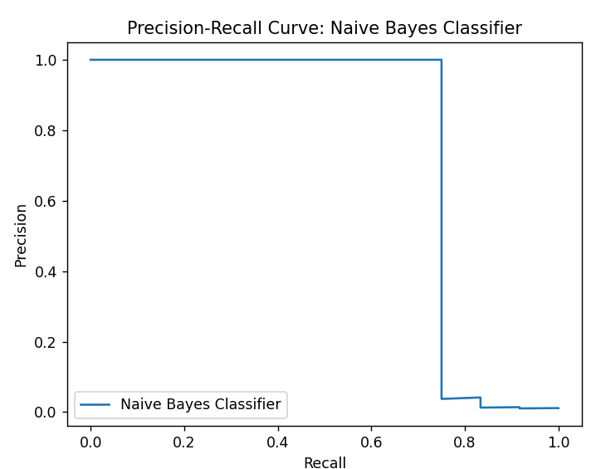
Precision-Recall Curve
Precision = How many predicted attacks were actually attacks
Recall = How many of the actual attacks were detected.
BEST?
High Precision, Recall, Curve close to Top-Right corner
Random forest, XGBoost, Voting Classifier – High Precision, Recall
SVM – Lower Precision, Recall
Naïve Bayes – Precision drops at lower thresholds

Slide 13
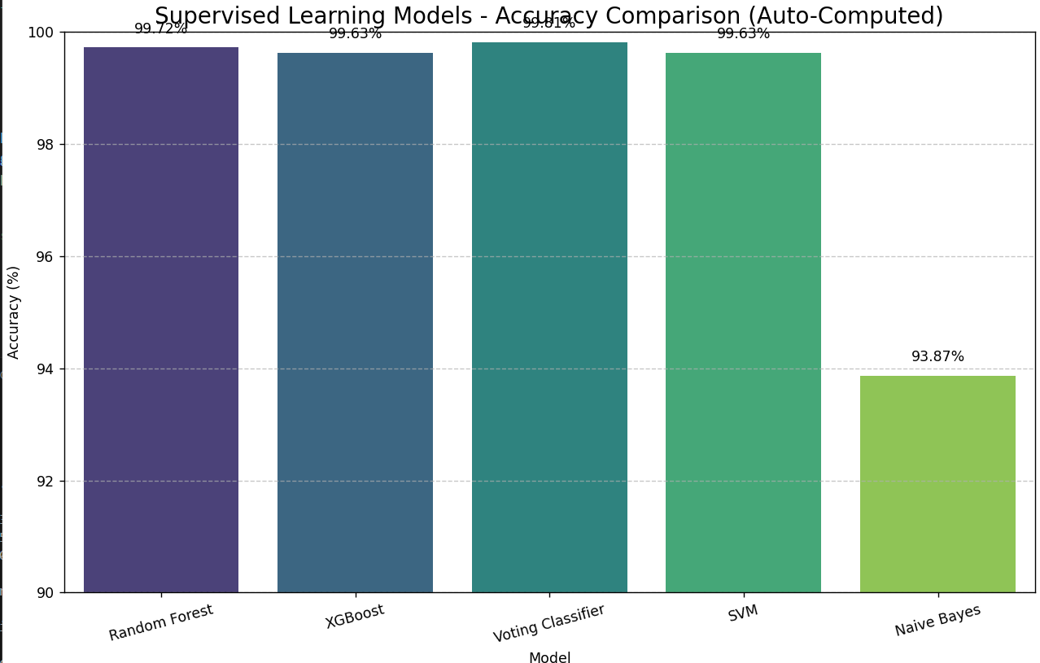
Results – Supervised Learning
Best Models
Voting Classifier
Random Forest
XGBoost
Model | Accuracy (%) | Precision (%) | Recall (%) | F1-Score (%) | AUC-ROC | Notes
Random Forest | 99.72 | 100.00 | 75.00 | 86.00 | 1.00 | Very strong, few false negatives
XGBoost | 99.63 | 75.00 | 100.0 | 85.71 | 1.00 | No false negatives, a few false positives
Voting Classifier | 99.01 | 91.67 | 91.67 | 91.67 | 1.00 | Best overall balance
SVM | 99.63 | 83.33 | 83.33 | 83.33 | 0.92 | Good but slightly weaker
Naive Bayes | 93.87 | 12.50 | 75.00 | 21.05 | 0.84 | Poor precision, high false positives
Challenges
Class Imbalance
Risk of Overfitting
False Negatives

Slide 14

What about Unlabeled Data?
Isn’t the Available Data Too Small?
Does Good Performance on Small Data Guarantee Good Real-World Performance?
How to Address These Concerns?
Semi-Supervised Learning (PU Learning) is the solution!

Slide 15
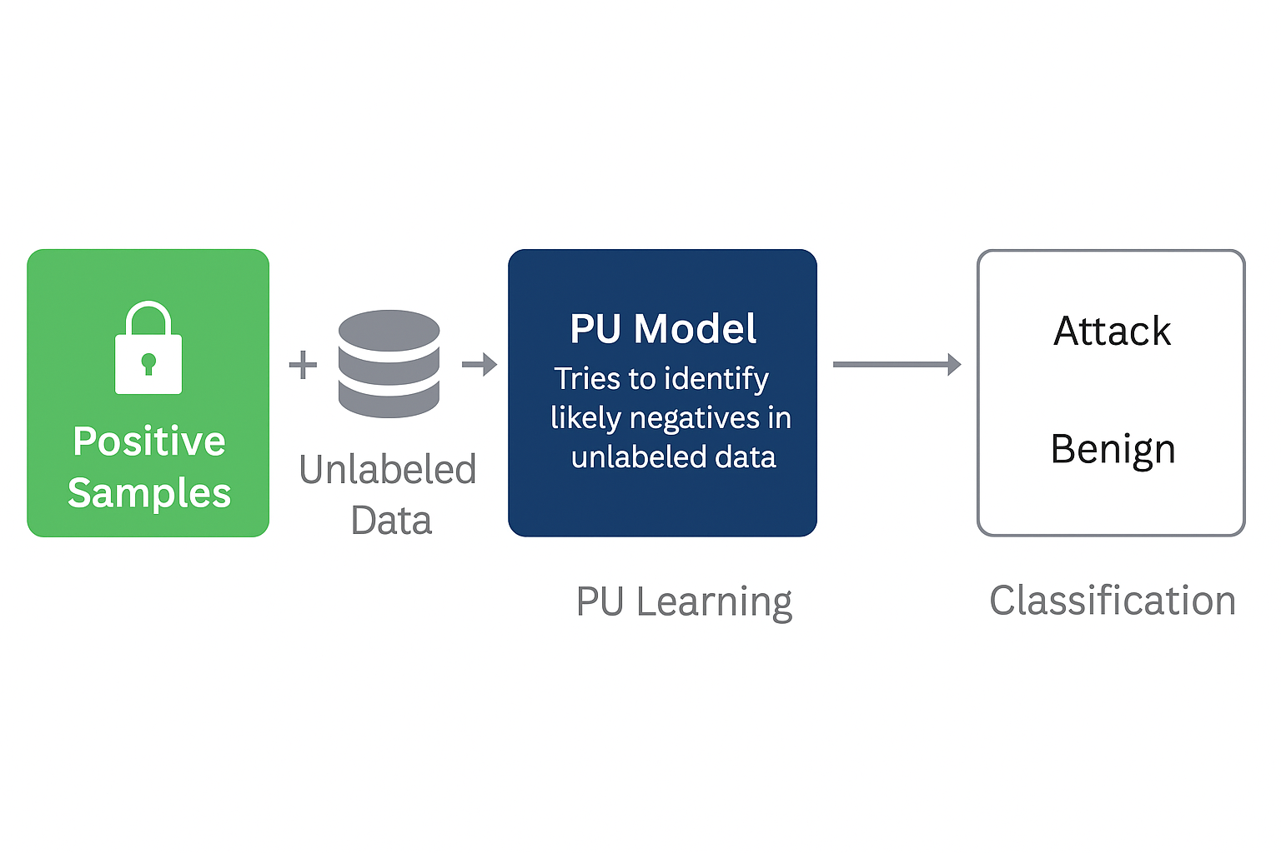
Introduction to PU Learning
What is PU Learning and Why?
How it Works?
Data Input → Positive + Unlabeled ↓ Model tries to identify likely negatives in unlabeled data ↓ Learns to classify attacks vs benign using semi-supervised methods
PU Learning is a type of semi-supervised learning where
Model learns using only positive samples (Attacks)
And unlabeled data (mixed Benign / Unknown)
Goal of using PU Learning?
To accurately detect attacks using known positive (attack) data and
Unlabeled (mostly benign) data.
Notes:
PU Learning is a type of semi-supervised learning where the model learns using only positive samples (e.g., known attacks) and unlabeled data (mixed benign/unknown).
Why?
Real-world datasets are mostly unlabeled, full labeling is time consuming & costly, helps to discover new or hidden aatacks.

Slide 16
Methodology
Step 1: Use only positive (attack) samples and unlabeled (benign + unknown) samples
Step 2: Apply PU Learning algorithms:
ElkanotoPU Classifier
Bagging PU Classifier
PU-SVM
Two-Step PU Learning
Step 3: Evaluate model performance using metrics:
Precision, Recall, F1-Score
ROC-AUC
Step 4: Compare predictions vs. supervised models
Data Split:
Labeled → Positive = 1 → Attack
Unlabeled = 0 → Mostly Benign + Unknown
Threshold Value: 20%

Slide 17


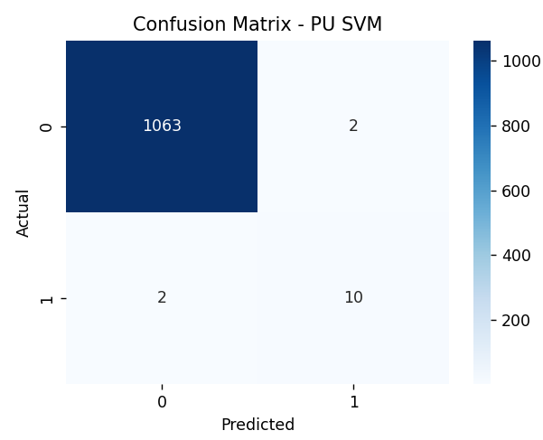
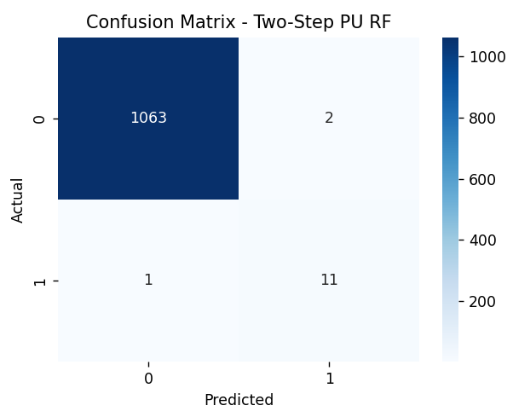
PU Learning
Confusion Matrix
Prediction performance for Elkanoto PU, Bagging PU, PU SVM and Two-Step PU Learning based on actual vs predicted classes
Two-Step PU Learning showed the best balance, Very few false positives, false negatives.
Bagging PU and SVM PU had good performance with slightly higher mistakes
Elkanoto PU struggled to identify attacks, mostly predicted as benign
Overall, PU Learning models were able to detect attacks reasonably well even without labeled negatives.
Notes:
It is crucial because in cybersecurity and intrusion detection, our main goal is to minimize False Negatives — meaning, we don't want to miss real attacks. False Positives are acceptable to some extent (false alarms), but missing an attack could be critical.
TP – correctly identified attacks
TN – correctly identified benign
FP – benign samples wrongly predicted as attacks
FN – Attacks wrongly predicted as benign

Slide 18
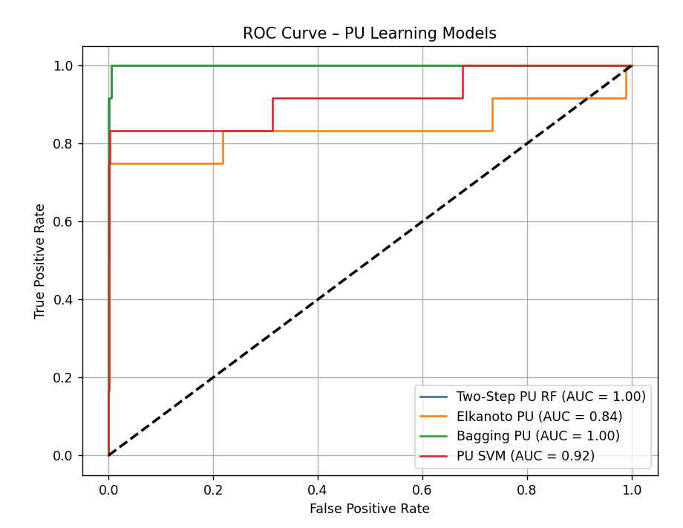
ROC – AUC Curve
ROC AUC Curve:
Two-Step PU ~ 1.0
Elkanoto PU ~ 0.84
Bagging PU ~ 1.00
PU SVM ~ 0.92
X-axis – False Positive Rate
Y –axis – True Positive Rate
AUC ~ 1.0 → Perfect Separation
AUC ~ 0.5 → Random Guessing
Two-Step PU, Bagging PU - Perfect Separation
PU SVM – Good, But less separation
Elkanoto PU – Struggles to separate positives & negatives

Slide 19
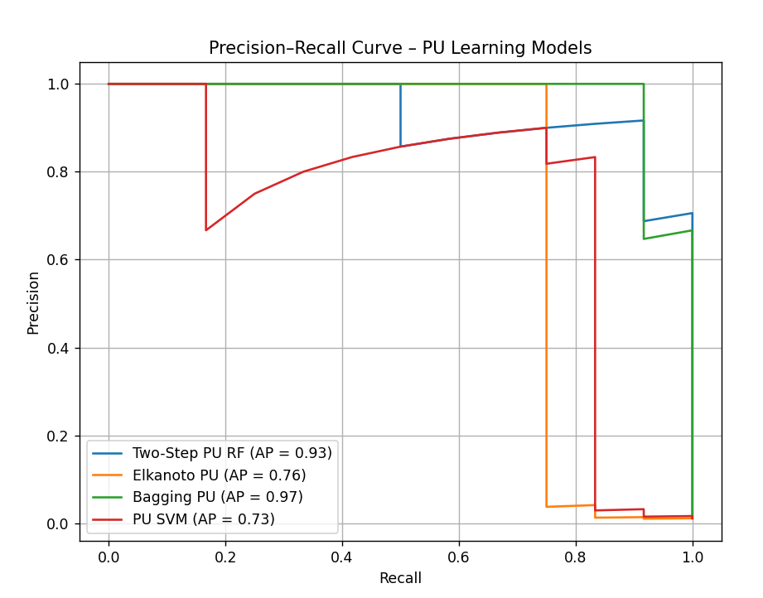
Precision- Recall Curve
Precision-Recall Curve:
Two-Step PU ~ 0.93
Elkanoto PU ~ 0.76
Bagging PU ~ 0.97→ Best
PU SVM ~ 0.73
X-axis – How many actual attacks are correctly detected
Y –axis – How many predicted attacks are truly attacks
AP (Average Precision) ~ 1 → Perfect
Higher AP is better
~curve closer to top-right Is better
Two-Step PU, Bagging PU - Excellent Precision & Recall
Elkanoto PU & PU SVM showed lower precision when recall
Increased
PRECISION is really important when detecting attacks!

Slide 20
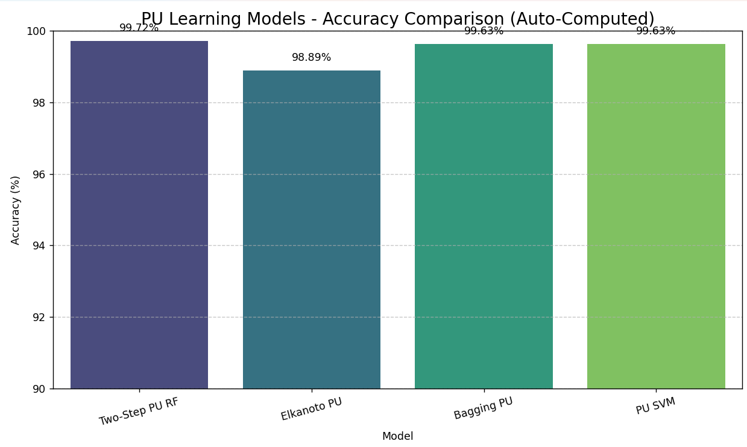
Results – PU Learning
Model | Accuracy (%) | Precision (%) | Recall (%) | F1-Score (%) | AUC-ROC | Notes
Two-Step PU RF | 99.72 | 93.00 | 91.67 | 88.00 | 1.00 | Best PU model with strong balamce
Elkanoto PU | 98.89 | 0.00 | 0.00 | 0.00 | 0.84 | Failed to detect positives
Bagging PU | 99.63 | 100.00 | 66.67 | 80.00 | 1.00 | High precision, missed some positives
PU SVM | 99.63 | 83.33 | 83.33 | 83.33 | 0.92 | Consistent performance

Slide 21
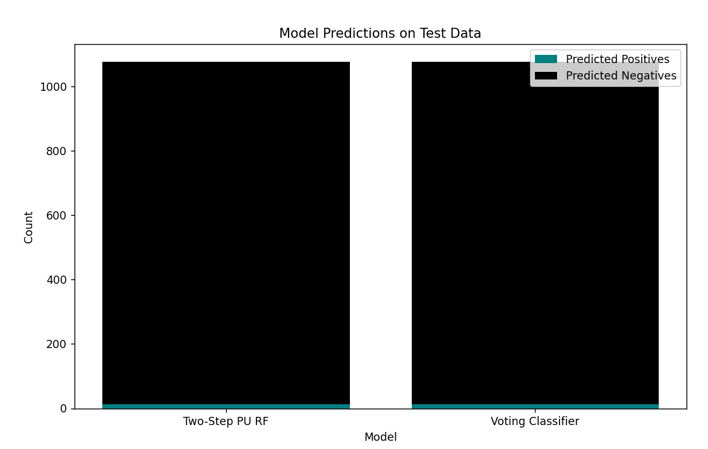
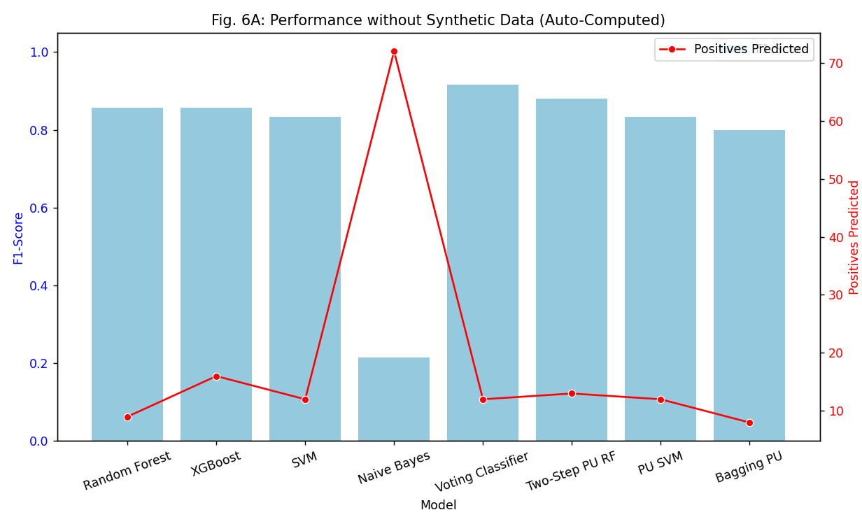
Supervised Learning vs PU Learning
Metric | Best Supervised Model (Voting Classifier) | Best PU Model (Two-Step PU RF)
Accuracy (%) | 99.01 | 99.72
Precision (%) | 91.67 | 93.00
Recall (%) | 91.67 | 91.67
F1-Score (%) | 91.67 | 88.00
AUC - ROC | 1.00 | 1.00
Notes | Required label data | Works with positives + unlabeled
Reliable Negatives Predicted | 2481 out of 2482
Model | Positives Predicted
Random Forest | 12
XGBoost | 12
SVM | 12
Naive Bayes | 81
Voting Classifier | 12
Two-Step PU RF | 13
PU SVM | 10
Bagging PU | 8
Elkanoto PU | 0
Unlabeled data challenge was effectively handled using PU Learning, especially with the Two-Step PU RF model, which achieved comparable results to the best supervised models
What About small dataset size and severe class imbalance?

Slide 22
Using Synthetic Data
Synthetic data is artificially generated data that mimics statistical properties of real data
Use of Synthetic Data:
To address class imbalance
To augment small dataset
To simulate edge cases
To preserve privacy
Project Goal?
To mitigate the severe class imbalance in original dataset and improve model performance or rare attack samples
How Synthetic Data was Generated?
For each numeric feature, synthetic values were generated using a Gaussian distribution with the same mean and standard deviation as the original data.
20% additional samples were created for both benign and attack classes.
This helped in augmenting rare attack cases and enhancing learning in imbalanced scenarios.
Type | Benign Samples | Attack Samples | Total Samples
Without Synthetic | 1,223,737 | 184,482 | 1,408,219
With Synthetic | 1,260,633 | 221,378 | 1,482,011

Slide 23
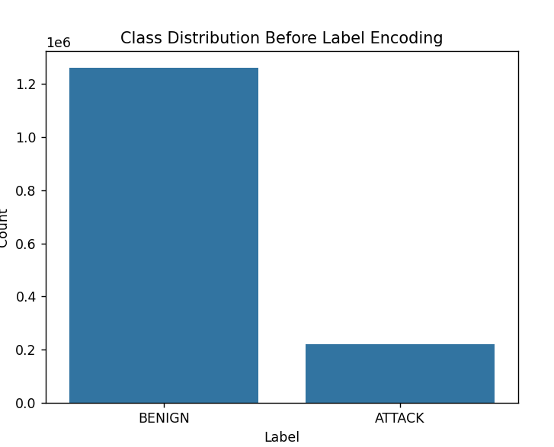
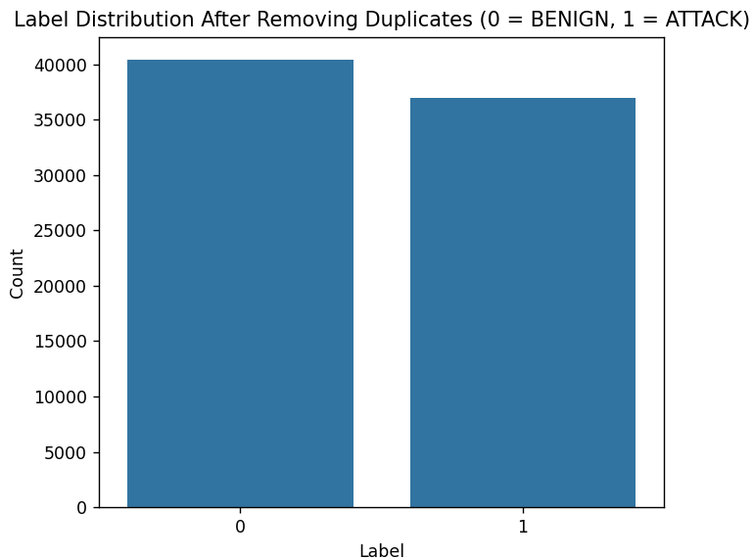
Data Preprocessing
Original Data:
Benign - 1,223,737
Attack – 184,482
Total Combined Data – 1,408,210
Synthetic Data:
Benign - 1,260,633
Attack – 221,378
Total Combined Data – 1,482,011
After Removing Duplicates and Missing Values (1,404,631)
Total Combined Data – 77,380
Benign – 40443
Attack – 36937
Notes:
In a real-world vehicle, the CAN (Controller Area Network) Bus continuously transmits the same types of messages repeatedly at very short intervals (every few milliseconds) to ensure that critical vehicle functions (like speed, brake status, RPM, steering angle) are monitored in real-time.
During both normal operation and attack scenarios (especially during DoS or spoofing attacks), the network logs high-frequency, identical messages many times.
As a result, when data is captured for analysis, it naturally contains millions of duplicate frames because:
The system broadcasts frequent status updates even when the vehicle’s status doesn’t change.
DoS attacks flood the CAN Bus with a huge volume of identical malicious packets.
Therefore, the duplication is a natural outcome of the high-frequency, repetitive communication patterns of CAN Bus systems in real-world vehicles.
It avoids overfitting, improves generalization, reduces bias, and trains the model on unique meaningful patterns.

Slide 24
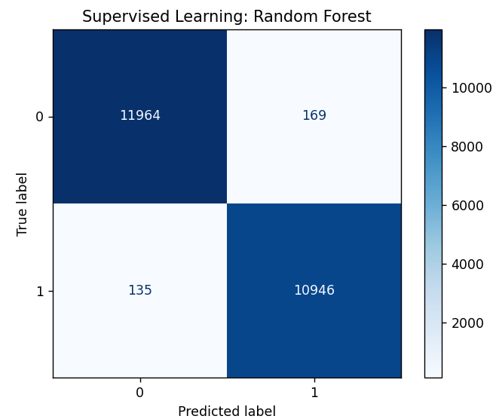


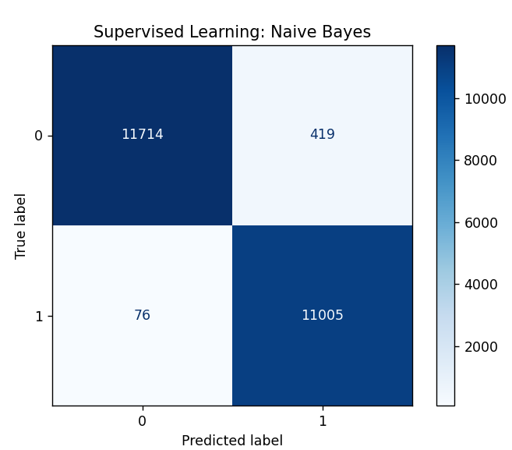
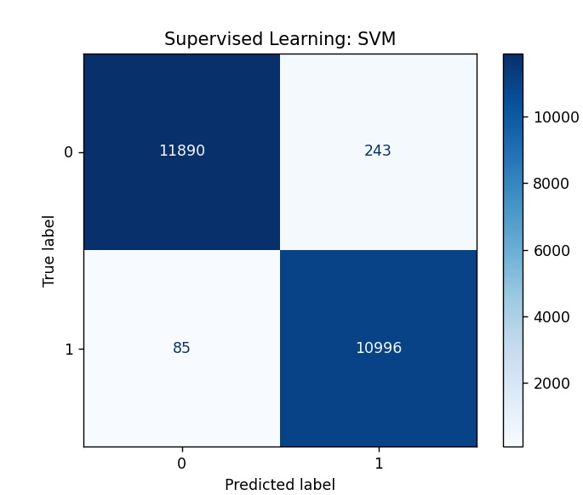
Supervised Learning
Confusion Matrix
Prediction performance for Random Forest, XGBoost, SVM, Voting Classifier, and Naive Bayes based on actual vs predicted classes
Random Forest achieved low False Positives and False Negatives, showing excellent performance. (Overall Balance)
XGBoost had low False Negatives but slightly more False Positives. (Attack Detection)
Voting Classifier maintained a very good balance with moderately low FP, FN. (Ensemble Stability)
SVM had minor errors — more False Positives than RF, XGB, VF
Naive Bayes struggled with many False Positives, causing lower precision.
Notes:
It is crucial because in cybersecurity and intrusion detection, our main goal is to minimize False Negatives — meaning, we don't want to miss real attacks. False Positives are acceptable to some extent (false alarms), but missing an attack could be critical.
TP – correctly identified attacks
TN – correctly identified benign
FP – benign samples wrongly predicted as attacks
FN – Attacks wrongly predicted as benign

Slide 25
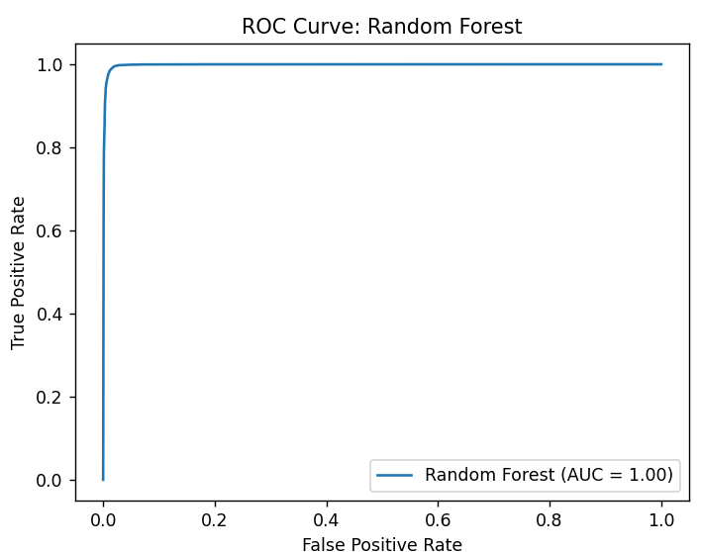
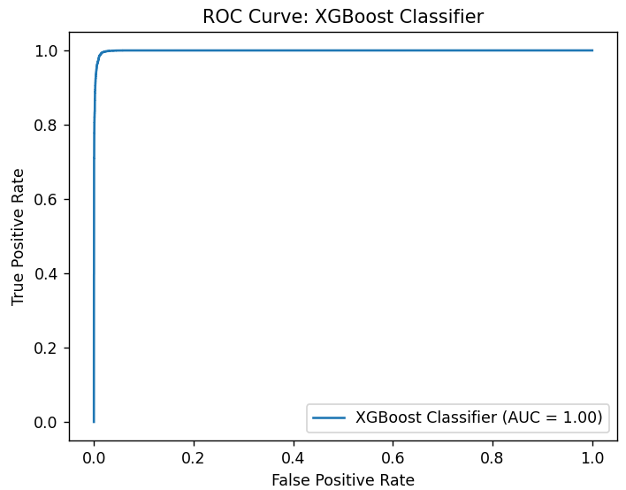
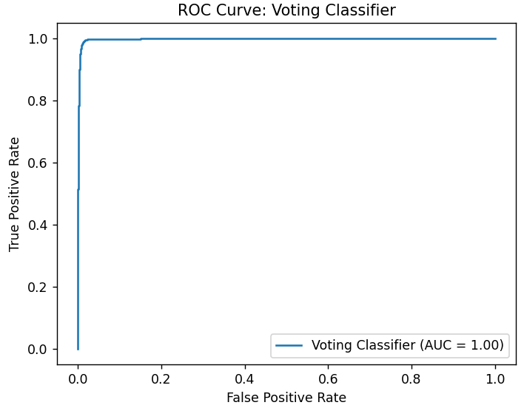
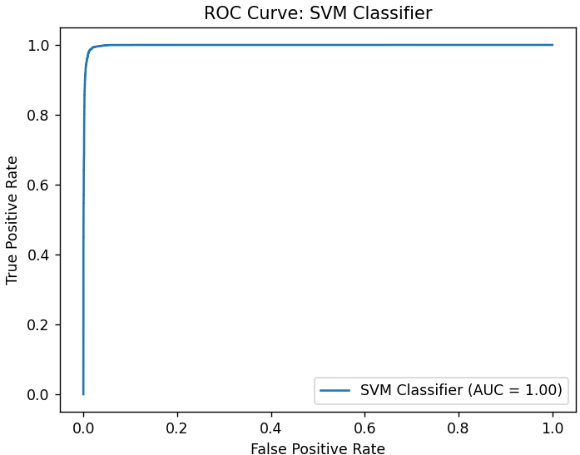
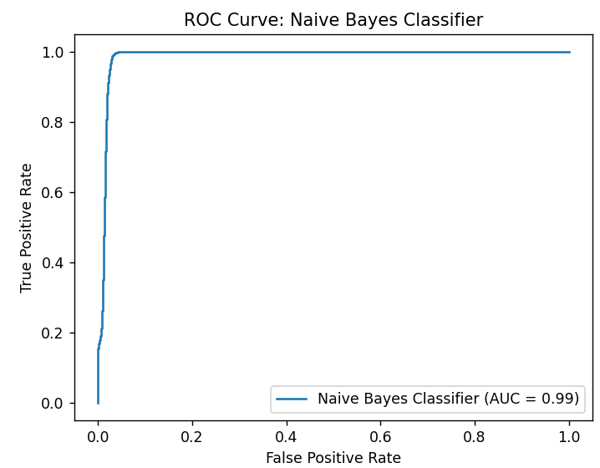
ROC – AUC Curve
What is ROC-AUC curve?
Shows the model’s ability to distinguish between classes(attack vs benign) at various threshold settings.
AUC ~ 1.0 (Excellent Classification)
Random forest, XGBoost, Voting Classifier – Perfect Separation
SVM – Good, but not perfect separation
Naïve Bayes – Lower ability
Notes:
Plots true positive rate(recall) against false positive rate
Curve closer to top left means better model performance
AUC – area under curve
Higher AUC(better ability to distinguish between classes

Slide 26
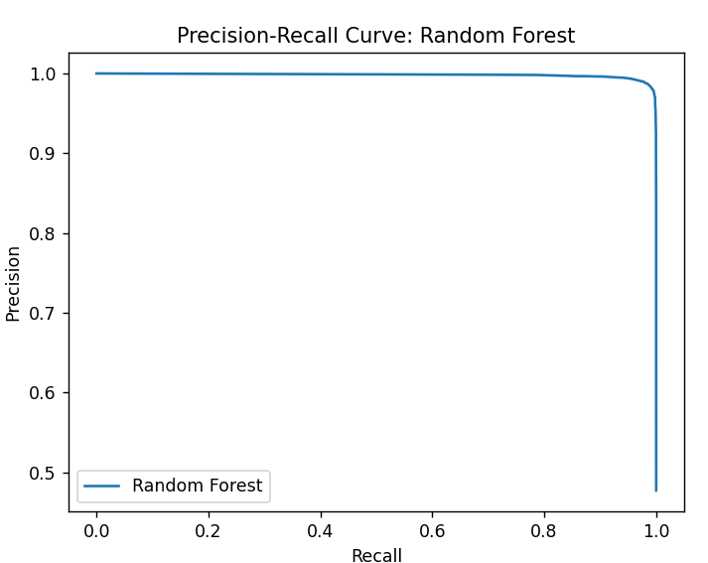




Precision-Recall Curve
Precision = How many predicted attacks were actually attacks
Recall = How many of the actual attacks were detected.
BEST?
High Precision, Recall, Curve close to Top-Right corner
Random forest, XGBoost, Voting Classifier – High Precision, Recall
SVM – Moderate Precision, Recall
Naïve Bayes – Precision drops at lower thresholds

Slide 27

Results – Supervised Learning
Best Models
Voting Classifier
Random Forest
XGBoost
Model | Accuracy (%) | Precision (%) | Recall (%) | F1-Score (%) | AUC-ROC | Notes
Random Forest | 98.84 | 98.91 | 98.45 | 98.68 | 0.99 | Strong precision-recall,
XGBoost | 98.72 | 97.60 | 99.74 | 98.66 | 0.99 | No false negatives, a few false positives
Voting Classifier | 98.87 | 99.45 | 99.41 | 99.43 | 0.99 | Best overall balance
SVM | 98.61 | 99.43 | 99.43 | 99.43 | 0.99 | Good Precision & Recall
Naive Bayes | 97.93 | 99.41 | 99.39 | 99.40 | 0.98 | Lower accuracy, Strong overall

Slide 28




PU Learning
Confusion Matrix
Prediction performance for Elkanoto PU, Bagging PU, PU SVM and Two-Step PU Learning based on actual vs predicted classes
Two-Step PU Learning showed the best balance, Very few false positives, false negatives.
Bagging PU and SVM PU had good performance with slightly higher mistakes
Elkanoto PU struggled to identify attacks, mostly predicted as benign
Overall, PU Learning models were able to detect attacks reasonably well even without labeled negatives.
Notes:
It is crucial because in cybersecurity and intrusion detection, our main goal is to minimize False Negatives — meaning, we don't want to miss real attacks. False Positives are acceptable to some extent (false alarms), but missing an attack could be critical.
TP – correctly identified attacks
TN – correctly identified benign
FP – benign samples wrongly predicted as attacks
FN – Attacks wrongly predicted as benign

Slide 29

ROC – AUC Curve
ROC AUC Curve:
Two-Step PU ~ 1.00
Elkanoto PU ~ 0.99
Bagging PU ~ 1.00
PU SVM ~ 1.00
X-axis – False Positive Rate
Y –axis – True Positive Rate
AUC ~ 1.0 → Perfect Separation
AUC ~ 0.5 → Random Guessing
Two-Step PU, Bagging PU - Perfect Separation
PU SVM – Good, But less separation
Elkanoto PU – Slightly less ideal than others, but still strong (AUC = 0.99)

Slide 30

Precision- Recall Curve
Precision-Recall Curve:
Two-Step PU ~ 1.0
Elkanoto PU ~ 0.98
Bagging PU ~ 1.00 → Best
PU SVM ~ 1.00
X-axis – How many actual attacks are correctly detected
Y –axis – How many predicted attacks are truly attacks
AP (Average Precision) ~ 1 → Perfect
Higher AP is better
~curve closer to top-right Is better
Two-Step PU, Bagging PU - Excellent Precision & Recall
PU SVM showed Higher precision, but curve shows more drop at certain recall points
Elkanoto PU – Strong, but lower precision
PRECISION is really important when detecting attacks!

Slide 31

Results – PU Learning
Model | Accuracy (%) | Precision (%) | Recall (%) | F1-Score (%) | AUC-ROC | Notes
Two-Step PU RF | 98.69 | 99.19 | 99.18 | 99.18 | 1.00 | Best PU model with strong balance
Elkanoto PU | 52.26 | 0.00 | 0.00 | 0.00 | 0.99 | Failed to detect positives
Bagging PU | 98.73 | 99.17 | 99.02 | 99.09 | 1.00 | High precision, missed some positives
PU SVM | 98.52 | 99.43 | 99.43 | 99.43 | 1.00 | Like Standard SVM

Slide 32


Supervised Learning vs PU Learning
Metric | Best Supervised Model (Voting Classifier) | Best PU Model (Two-Step PU RF)
Accuracy (%) | 98.87 | 98.69
Precision (%) | 99.45 | 99.19
Recall (%) | 99.41 | 99.18
F1-Score (%) | 99.43 | 99.18
AUC - ROC | 0.99 | 0.99
Notes | Required label data | Works with positives + unlabeled
Reliable Negatives Predicted | 27939 out of 28310
Model | Positives Predicted
Random Forest | 10962
XGBoost | 11008
SVM | 11008
Naive Bayes | 11018
Voting Classifier | 10991
Two-Step PU RF | 10988
PU SVM | 11008
Bagging PU | 10968
Elkanoto PU | 0
Unlabeled data challenge was effectively handled using PU Learning, especially with the Two-Step PU RF model, which achieved comparable results to the best supervised models
To address class imbalance and data scarcity, 20% additional samples were generated for both benign and attack classes using Gaussian-based feature sampling. This increased the final usable dataset from approximately 3,500 to over 77,000 instances after removing duplicates. As a result, the label distribution became more balanced, leading to improved model generalization and better detection of rare attack patterns.

Slide 33




Original Data vs Synthetic Data
Synthetic data improved F1-score drastically, especially for Naive Bayes and Bagging PU.
Recall and Precision reached near-perfect values across models.
Synthetic augmentation helped reduce class imbalance effects and improved model generalization.
PU Learning models like Two-Step PU RF became more reliable after augmentation.
Adding synthetic data significantly boosts model reliability, especially under class imbalance. It enhances recall and precision consistency across both supervised and PU learning models. Two-Step PU RF and Voting Classifier stand out in both scenarios.

Slide 34
Existing Work vs Our Work
Study | Dataset | Technique | Limitations | Improvements
Amirudin et al. | CICIoV2024 | LightGBM, CatBoost | No PU learning, no synthetic data, risk of overfitting | PU learning + Gaussian synthetic data augmentation
Neto et al. | CICIoV2024 | Logistic Regression, RF | Fixed vehicle data, no advanced PU or ensemble techniques | Ensemble models (RF, XGBoost, Voting), PU models
Aswal et al. | CICIoV2024 | DNN | No comparison with ML/PU methods, lacks scalability | Supervised + PU comparison + cross-validation
Metric | Amirudin et al. | Our Work (Without Synthetic) | Our Work (With Synthetic)
Dataset | CICIoV2024 | CICIoV2024 (deduplicated) | CICIoV2024 + Synthetic Data
Models Used | LightGBM, CatBoost | RF, XGB, SVM, NB, Voting | RF, XGB, SVM, NB, Voting
Best Accuracy | 98.82% | 99.81% (Voting Classifier) | 98.79% (Voting Classifier)
Best F1-Score | ~0.91 | 0.92 (Voting) | 0.99 (RF/XGB/Voting)
Class Imbalance Handling | Not addressed | Still imbalanced (3.5K samples) | Solved with Gaussian augmentation (77K samples)
Data Size Used | Not specified | 3,588 | 77,380

Slide 35


A/B Testing – Impact of Synthetic Data on Model Performance
A/B Testing compared model performance with Original Data and Synthetic Data
Paired t-test on F1-Score:
T = -2.63
P = 0.0339
Statistically significant improvement (P < 0.05)
~ Models trained on original data failed to predict positive (attack) samples effectively.
Synthetic data improved detection of minority class (attack) by balancing the dataset.
Naive Bayes showed the most dramatic improvement (F1 ↑ by 76.3%).
Overall, synthetic augmentation led to better generalization across all models.

Slide 36
Conclusion
This work established an intrusion detection system for Internet of Vehicles (IoV) using supervised learning methods supplemented with synthetic data and PU learning approaches. Our models reached F1-scores of up to 0.99 following cleaning efforts and class imbalance correction on the CICIoV2024 dataset. The system proves practical value in real-world applications because it functions when complete labeled data is inaccessible. The implementation of PU learning detects suspicious behaviors regardless of minimal understanding about attack behaviors which makes it appropriate for deployment within modern connected vehicles for securing the CAN Bus against real-time threats.
Real-World use of this project
The research findings provide instant applicability for detecting cyber threats which currently affect real-world connected vehicles. Speed fuel and location data monitoring within a fleet delivery truck operation runs through smart systems. The manipulations of speed data as part of spoofing attacks could result in hazardous driving behavior as well as inappropriate system notification alerts. Our intrusion detection system enables real-time detection of abnormally behaving communication patterns through its PU learning and synthetic data training even though unlabeled similar attacks existed previously. The implemented security measures guarantee vehicles maintain both safety and dependability while staying alert to cyber dangers while driving.

Slide 37
Future Work
Test PU Learning Under Varying Positive-to-Unlabeled Ratios
In real-world settings, the proportion of labeled attacks can be very small or imbalanced.
Future experiments should evaluate PU models under different ratios (e.g., 10%, 20%, 50% positive samples) to test their stability and robustness.
Apply to Real-Time CAN Bus Data
Deploy the trained models in live vehicle environments to assess performance under actual communication traffic.
Explore Deep PU Learning Methods
Investigate advanced techniques like nnPU, non-negative risk estimators, or deep generative PU models to enhance learning from minimal labels.
Integrate Anomaly Detection with PU Learning
Combine unsupervised anomaly detection with PU models to improve zero-day attack detection.
Feature Engineering Using Domain Knowledge
Use expert knowledge of CAN Bus message structures to create more interpretable and meaningful features.
Optimize for Edge Deployment
Compress and convert models for real-time execution on embedded vehicle systems with limited processing power.

Slide 38

Dr. Zhiqian Chen
Major Professor
Department of Computer Science Bagley College of Engineering
Mississippi State University
Mississippi, United States
Dr. Charan Gudla
Project Director
Department of Computer Science Bagley College of Engineering
Mississippi State University
Mississippi, United States
Dr. Jon Woody,
Committee Member
Department of Mathematics & Statistics Bagley College of Engineering
Mississippi State University
Mississippi, United States

